Slide 1



DOMINICK BUI
Supervisor, Starlink Enterprise Customer Support
https://starlink-puce.vercel.app/

Slide 2
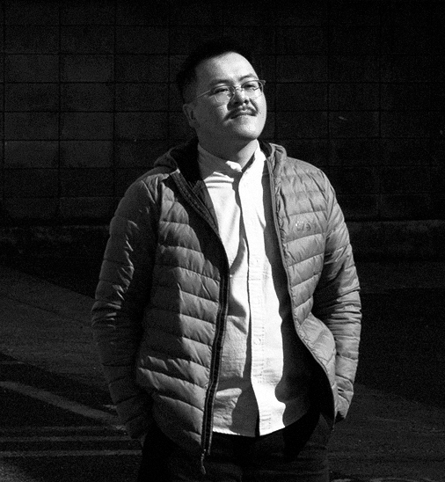
Who I am
A Customer Experience leader with a background in building support teams and systems from the ground up.
I helped launch the U.S. support team at Back Market during peak COVID, scaled a LATAM call center, and led programs that drove operational excellence and improved customer outcomes.
I’m scrappy, thrive under pressure, and love collaborating cross-functionally to build systems that make life easier for both customers and support teams.
SpaceX—Starlink
https://starlink-puce.vercel.app/
2025

Slide 3
30—60-day Plan
Week 1
Week 2
Week 3
Week 4
Week 5
Week 6
Week 7
Week 8
Build trust and rapport with the team while gaining a deep understanding of existing Enterprise Support operations. Align with key stakeholders to prioritize meaningful reporting cadence, foster team chemistry, and gradually plan for impactful process improvements
→ Onboard with HR & IT, gain system access
→ Intro meetings with leadership & team to build rapport → Review Org structure and Enterprise Support Ops
→ Deep-dive into ticketing, Knowledge Base, dashboards, SLAs, QA process
→ Continue 1:1s and meet cross-functional collaborators
→ Shadow agents on common and complex tickets
→ Continue review of Knowledge Base, dashboards, QA process, ISO 9001 & regulatory docs
→ Begin resolving low-complexity tickets
→ Start weekly syncs with leadership & direct reports
→ Analyze ticket flow, volume, and handoffs
→ Identify top performers & coaching opportunities
→ Review hand-offs, staffing, and Support coverage for holidays
→ Continue resolving tickets
→ Continue 1:1s and establish reporting cadence with Enterprise Support team
→ Begin team performance reviews
→ Identify areas for improvement of onboarding docs for clarity & accuracy
→ Investigate edge-case tickets
→ Optimize staffing
→ Continue resolving tickets
→ Begin structured performance coaching based on ticket data, CSAT, and peer feedback
→ Use dashboards to spot bottlenecks or inconsistencies in processes
→ Draft plan for streamlining high-friction workflows
→ Align with leadership on Q3 Roadmap
→ Pilot small changes to workflows or QA process
→ Continue coaching with low performers and highlight quick wins in team standups
→ Host sessions with team to gather feedback on onboarding, tooling, and process friction
→ Begin shift audit-identify potential coverage gaps, idle time, or overcapacity
→ Present summary findings and early wins to leadership
→ Align with leadership + stakeholders on proposed improvements
→ Revisit SLAs, internal playbooks, and shift coverage plans — propose draft updates based on observations and team input
→ Define a repeatable cadence for team reviews, stakeholder updates, and retros
→ 1:1s with team to gather feedback on my leadership and impact so far
→ Identify longer-term tooling or workflow gaps that require engineering or vendor input
→ Prepare insights for performance calibration or promotion recommendations if applicable
SpaceX—Starlink
https://starlink-puce.vercel.app/
2025

Slide 4

PayPal Transformation
Program Spotlight
On the Path to Repairing a Legacy PayPal Integration
SpaceX—Starlink
https://starlink-puce.vercel.app/
2025

Slide 5
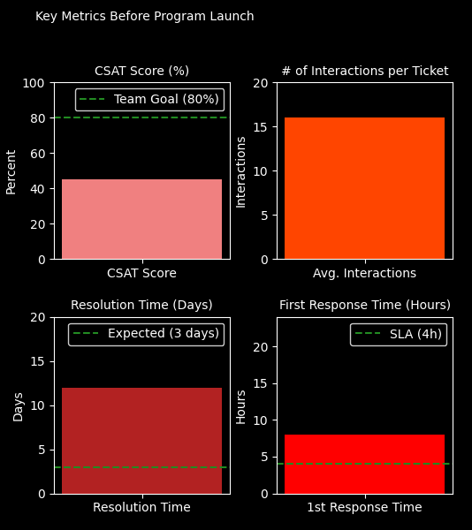
A legacy PayPal integration blocked refunds after 180 days—leaving customers waiting days, sometimes weeks, for their money back.
This support failure led to:
Delayed resolutions (~7–14 days)
Excessive agent touchpoints (~15+)
Errors and inefficient escalations
High customer frustration and churn risk
Erosion of customer trust in support
Reputational damage and revenue loss
The result: operational inefficiencies, diminished agent confidence, and lingering technical debt.
The Situation
SpaceX—Starlink
https://starlink-puce.vercel.app/
2025

Slide 6
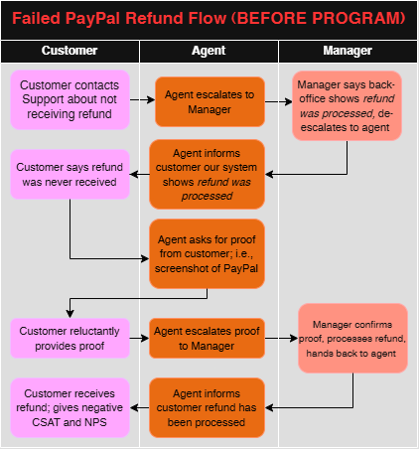
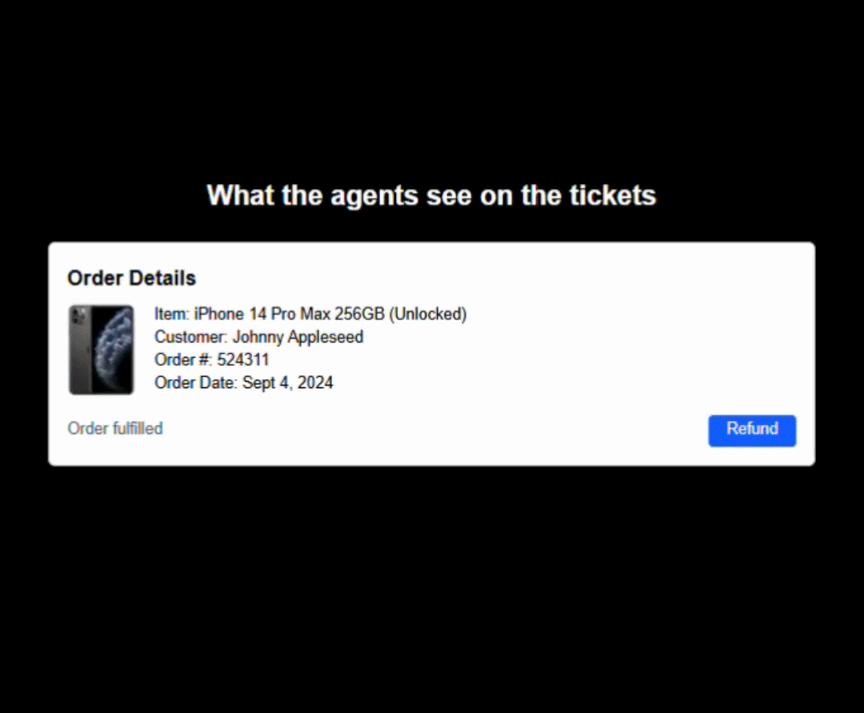
What needed to change
Refund customers within 1 business day (instead of 7–16 days)
Reduce resolution time from 1–2 weeks to < 2 hours
Reduce # of interactions from 10-16 to < 4
Eliminate manual errors and reduce unnecessary escalations
Design a streamlined workflow
Align with Finance to recover the refunds from vendors
Challenges
(1) Agent Enablement, (2) Process Friction, (3) Customer Trust, (4) Cross-functional ambiguity, (5) Lack of Engineering resources, (6) Scalability, and (7) Delayed HyperWallet Rollout
The Tasks
SpaceX—Starlink
https://starlink-puce.vercel.app/
2025

Slide 7
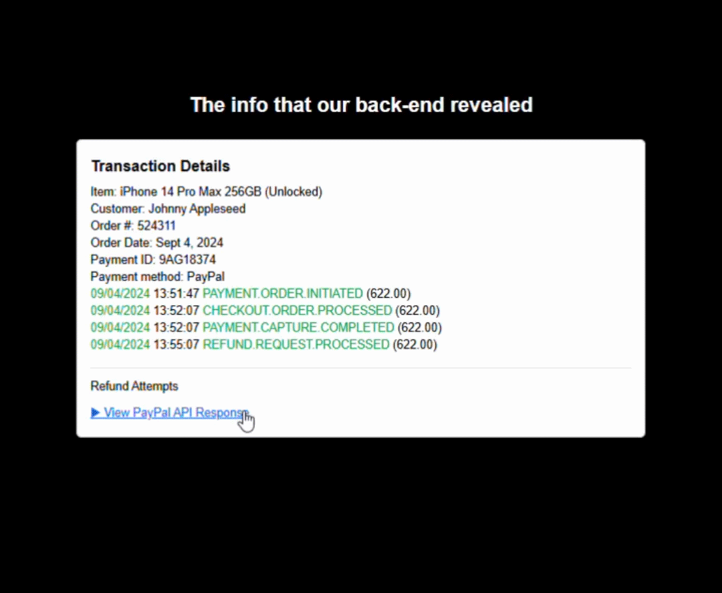
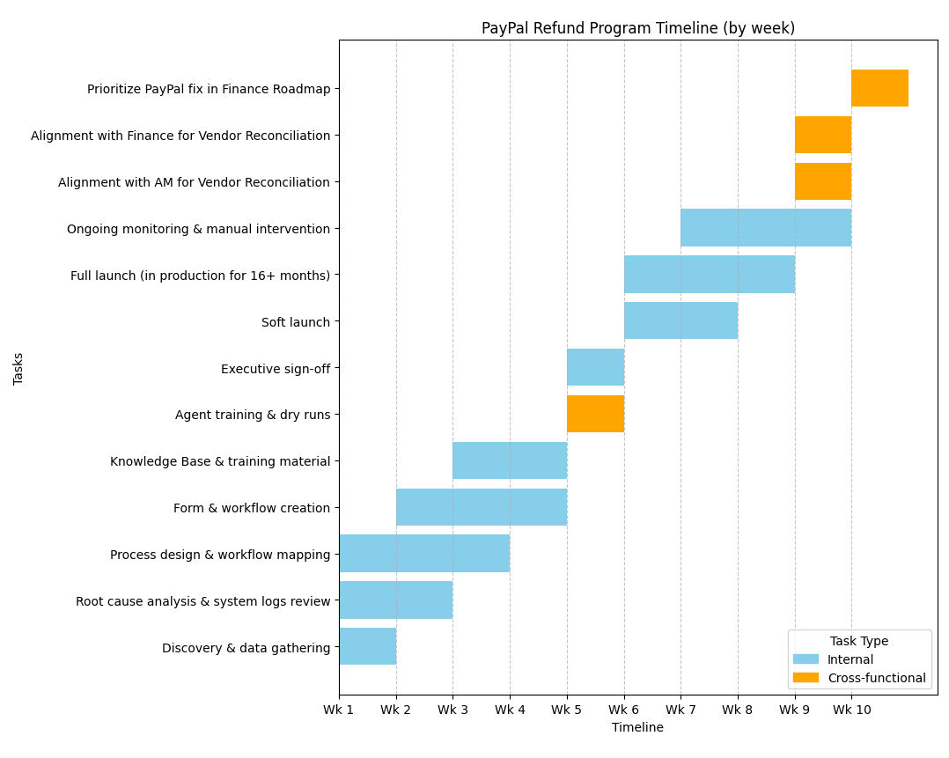
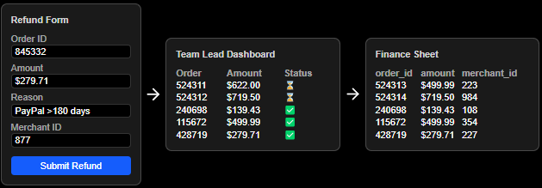
Discovery and Root Cause Analysis
Analyzed tickets and system logs to confirm refund failures rooted in PayPal API limitation
Design and Build
Built a streamlined process for agents to that validate payment failures and to submit refunds via a form
Agent Enablement & Training
Built SOPs, troubleshooting guides, and a training deck
Led live sessions to ensure clarity and adoption across the team
Launch and Alignment
Soft launch with pilot group, executive sign-off, and then company-wide full launch
Alignment with Finance and Account Management
Ongoing Monitoring
Continued alignment with Finance to ensure monthly vendor reconciliation and adoption of HyperWallet
The Actions
SpaceX—Starlink
https://starlink-puce.vercel.app/
2025

Slide 8

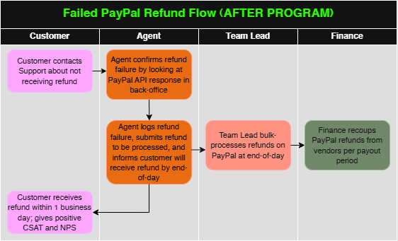
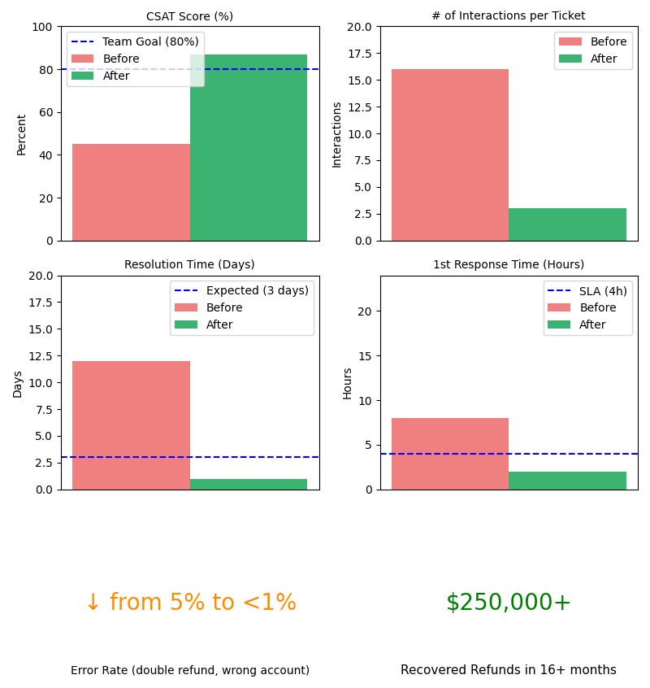
The Results
Customer Satisfaction jumped from ~50% to over 85%
Resolution time improved from 12 days to under 2 hours
Touchpoints per ticket fell by over 95%, simplifying agent workflows
First response time improved became over 70% faster
Error rate reduced from 5% to < 1%
Recovered over $250,000 from vendors
Influenced Finance roadmap to implement enterprise-wide change to payment infrastructure (PayPal HyperWallet)
SpaceX—Starlink
https://starlink-puce.vercel.app/
2025

Slide 9

Thank you for listening!
SpaceX—Starlink
https://starlink-puce.vercel.app/
2025

